Slide 1

Brain tumor segmentation
Using deep neural networks
Hashiru Pramuditha
Namina Wijetunga

Slide 2
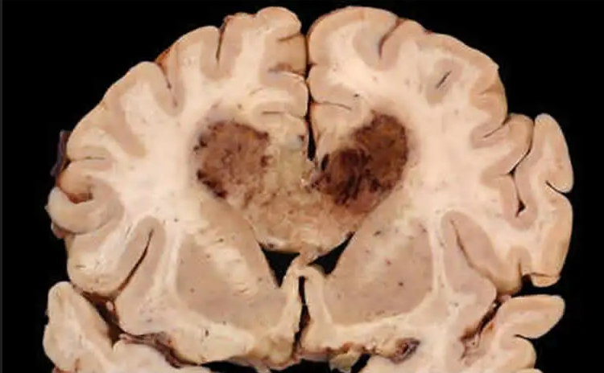
Outline for the problem
A brain tumor is an abnormal mass of tissue in which cells grow and reproduce uncontrollably, seemingly unrestricted by the processes that govern normal cells.
Although there are over 150 distinct types of brain tumors known to exist, primary and metastatic brain tumors are the two main categories.
Brain tumor at early stage is very difficult for doctors to identify since MRI images are more prone to noise and other environmental interference.

Slide 3
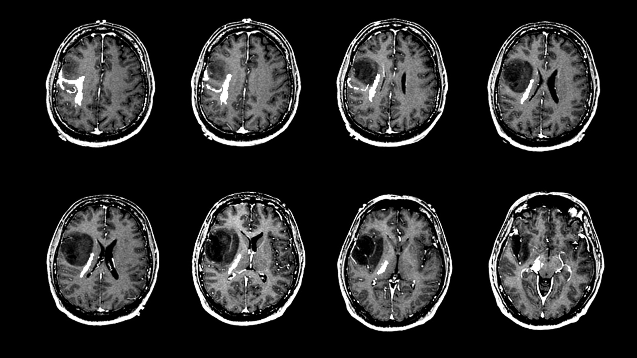
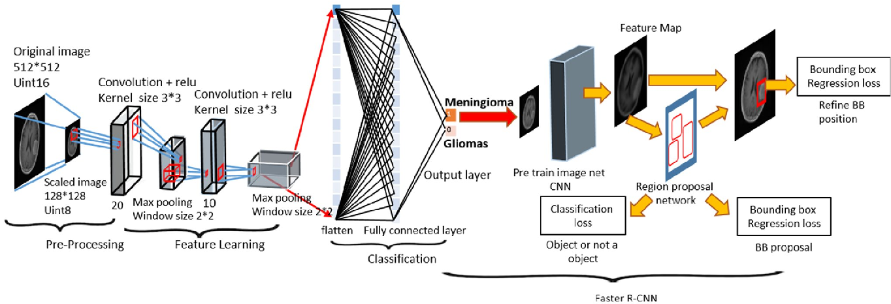
Proposed solution
Convolutional Deep Neural Networks
By implementing convolution based deep neural networks with image segmentation techniques, brain tumor can be effectively detected and segmented at their early stages.
Here, we present a model which will learn from the given data and identify and segment the possible tumor regions intelligently.
The model architecture mainly consists with four stages,
1. Preprocessing
2. Image Segmentation
3. Feature Extraction
4. Prediction
https://images.app.goo.gl/6HpT9qyotiDr6bzF9

Slide 4
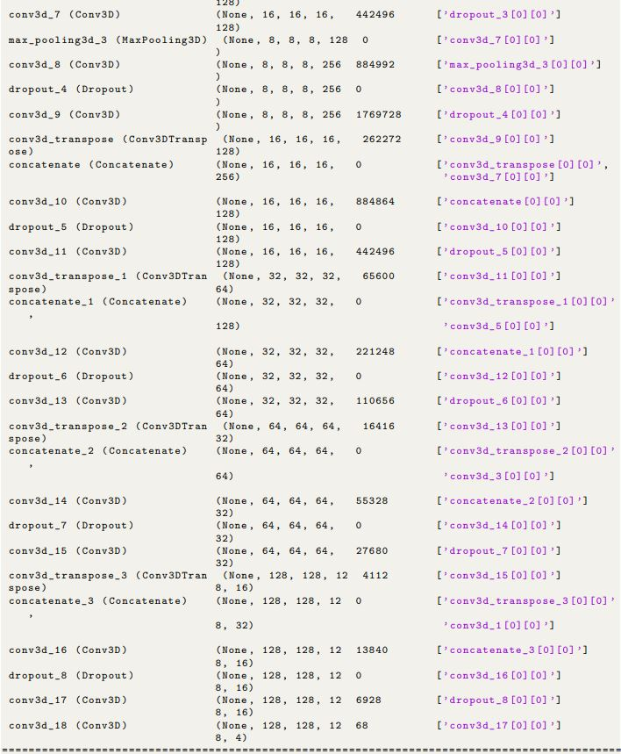
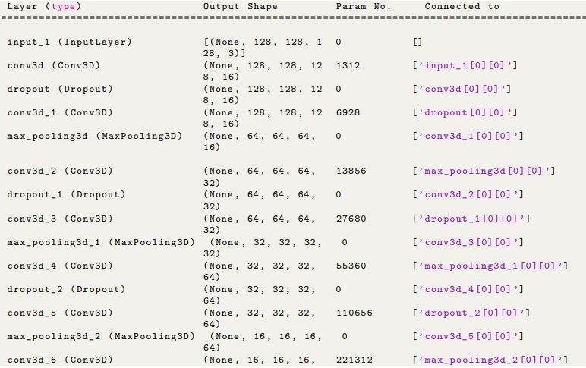
Neural network architecture
A Simple u-net model
The neural network architecture is developed by using 3-D convolutional layers with the combination of pooling and dropout layers.

Slide 5
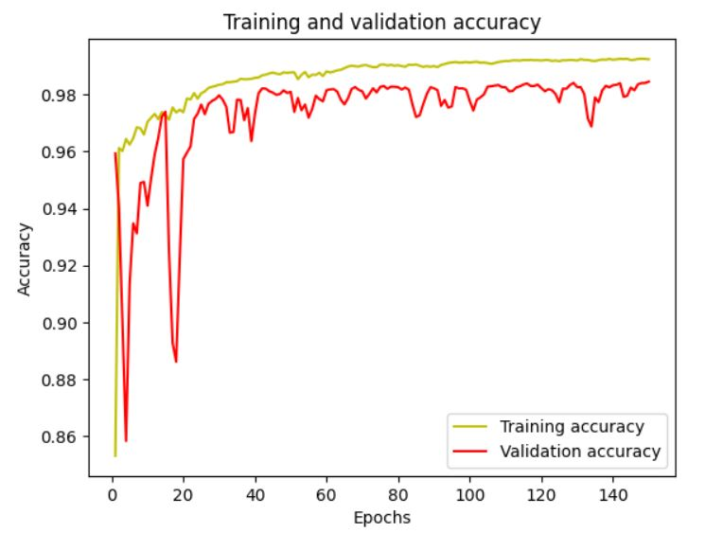
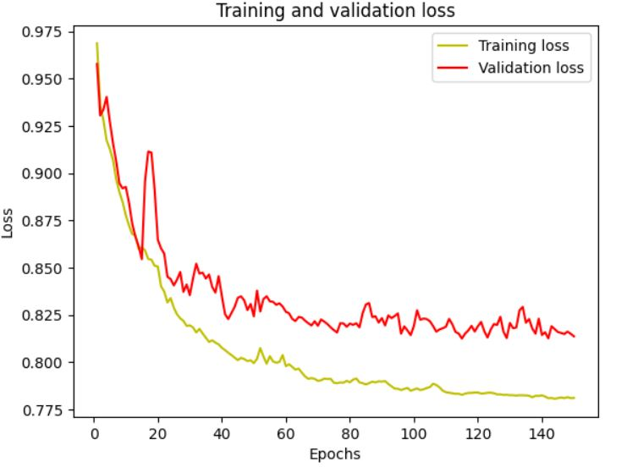
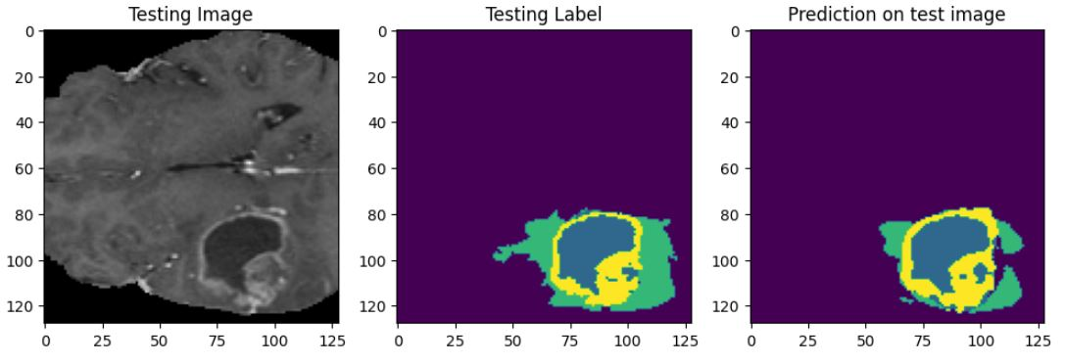
Results of the proposed model
cumbersome yet effective
Mean IoU = 0.6248

Slide 6
THANK YOU

